Slide 1
BLOG NAME:
PHOTOGRAPHY LUB

Slide 2
CATEGORY:
DIGITAL MARKETING

Slide 3
EMAIL: photographerslub@gmail.com

Slide 4
WORD PRESS BLOG URL: https://photography2979.wordpress.com/2023/10/31/photography

Slide 5
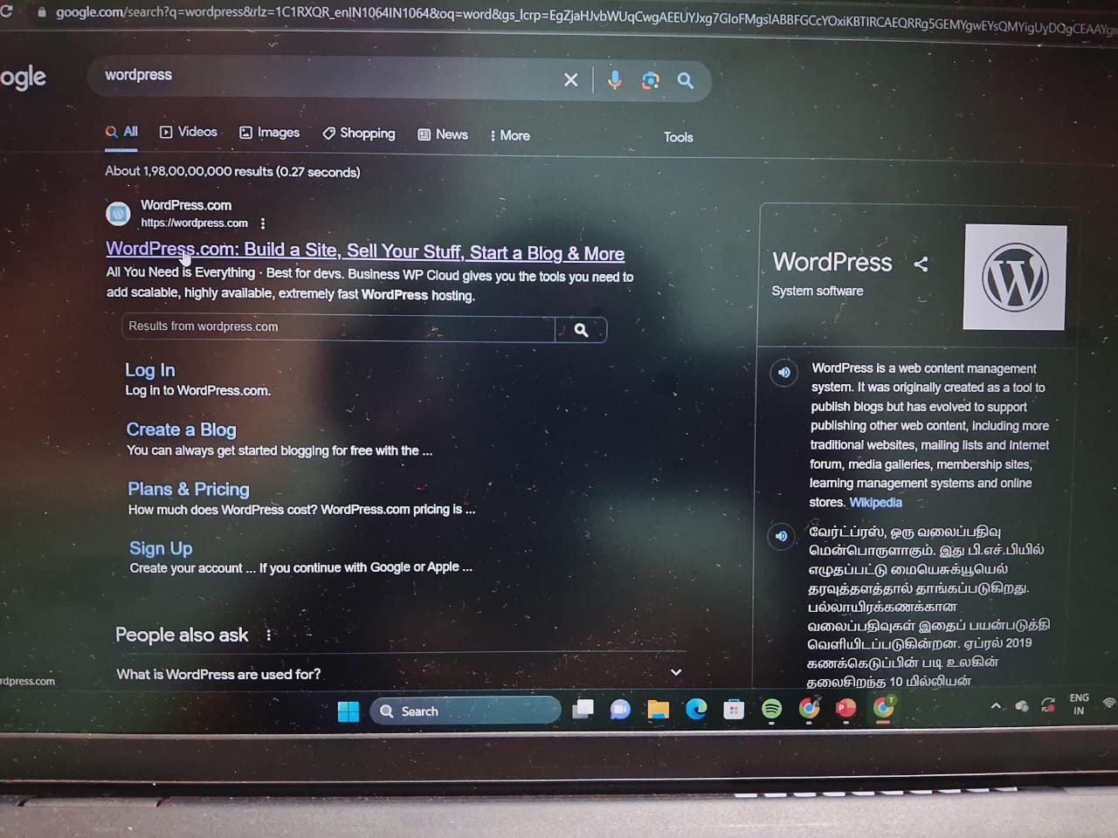
STEP 1:OPEN WORDPRESS.COM IN CHROME

Slide 6
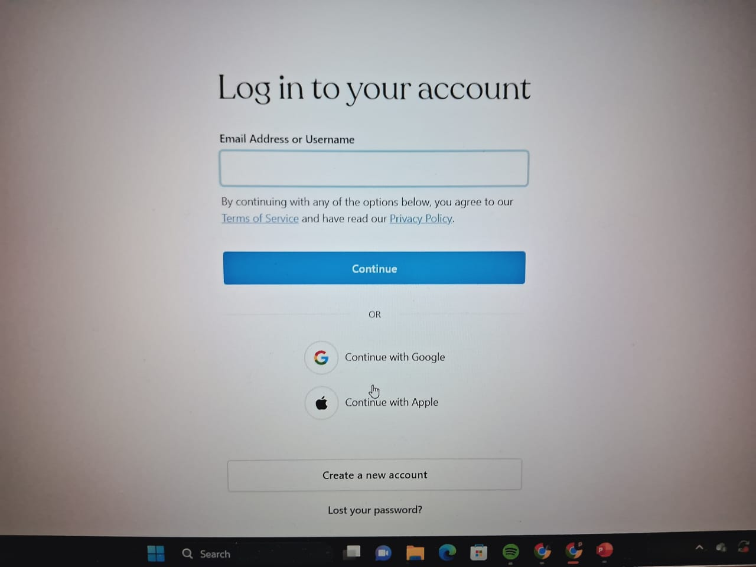
STEP 2:LOG IN OR SIGN UP TO WORDPRESS
.

Slide 7
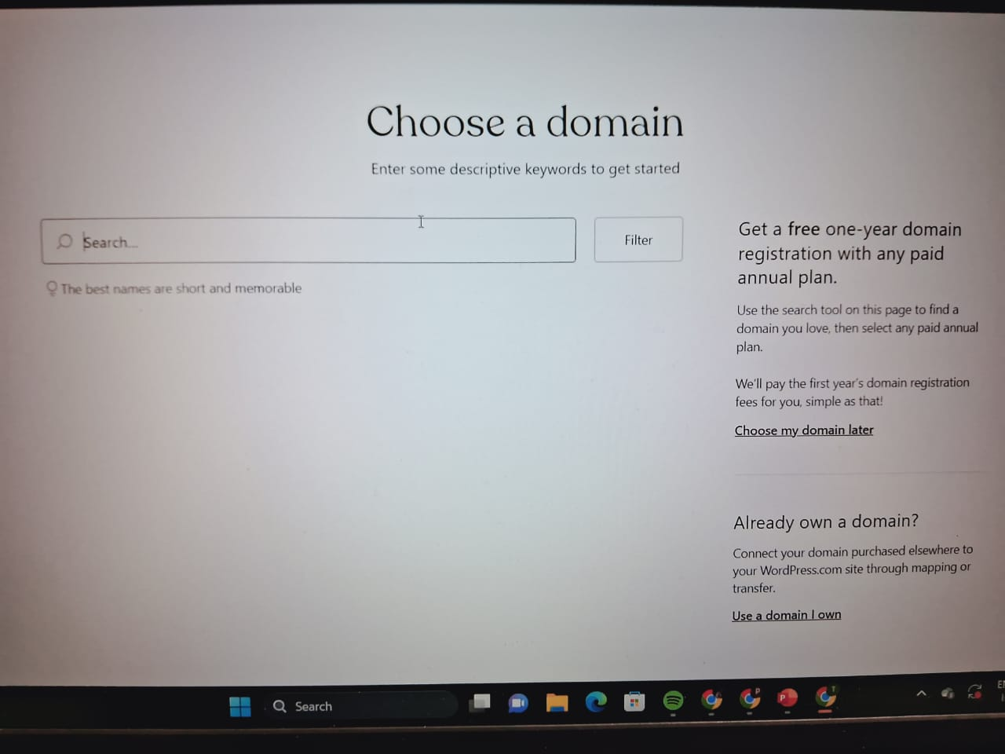
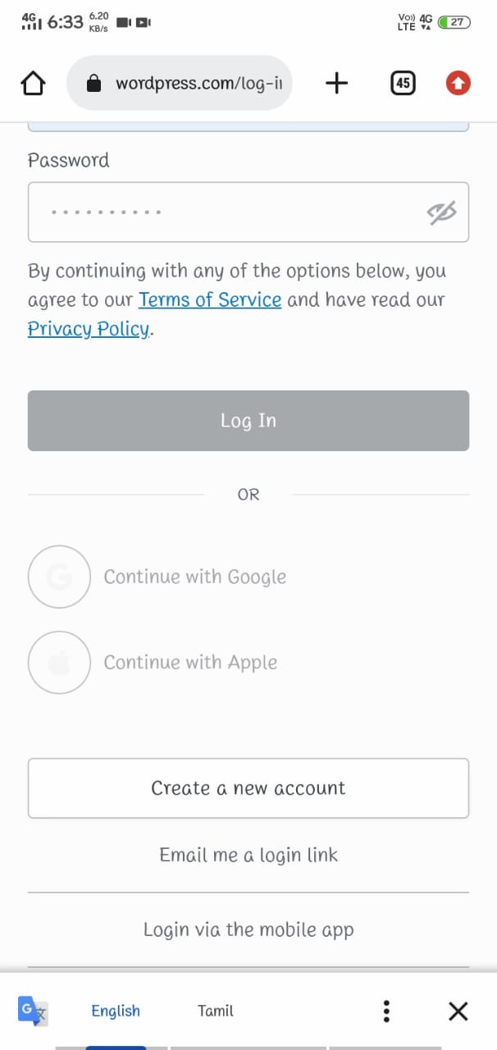
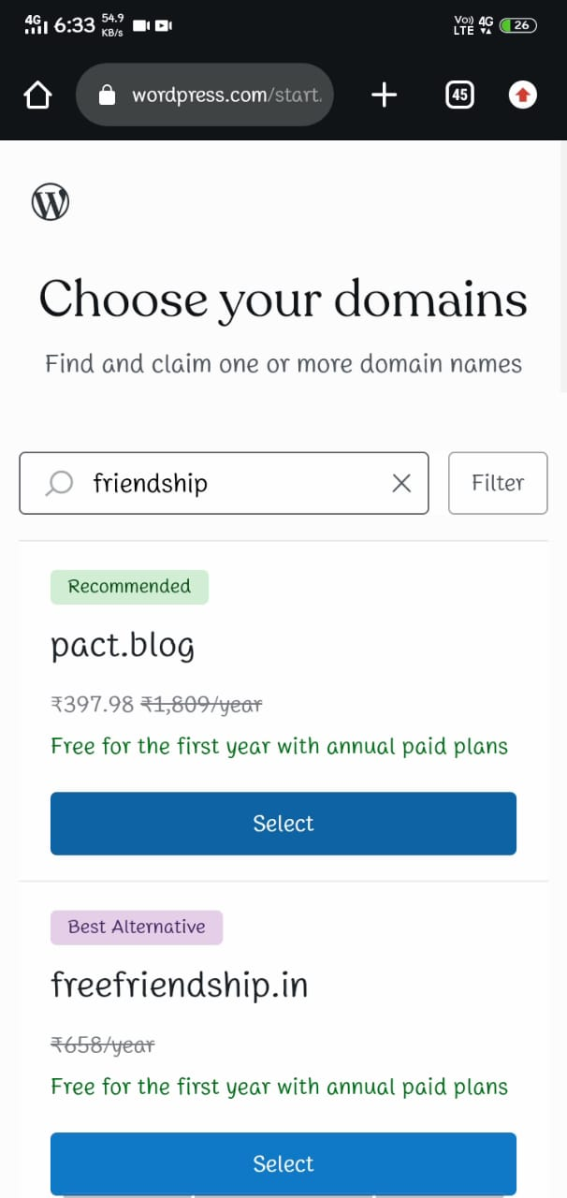
STEP:3ENTER YOUR DOMAIN

Slide 8
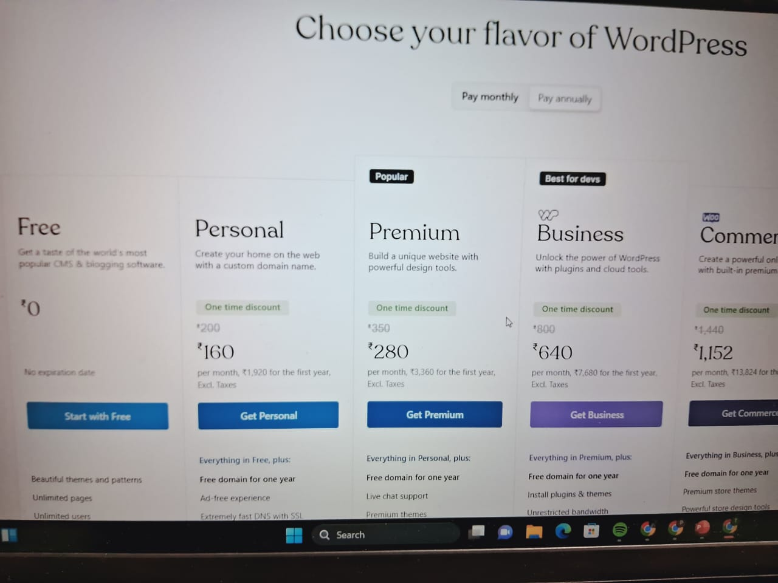
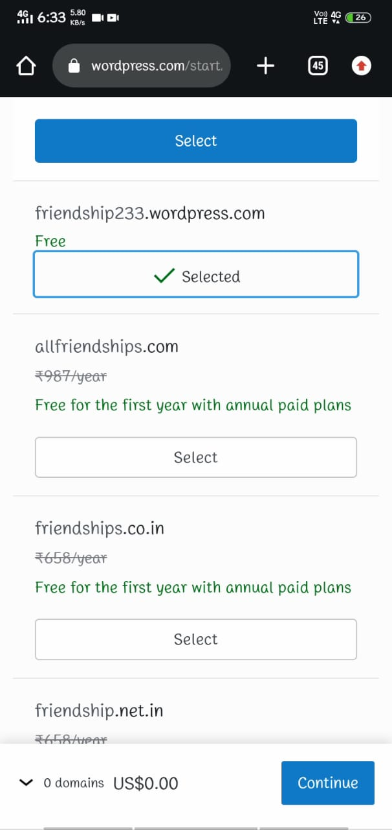
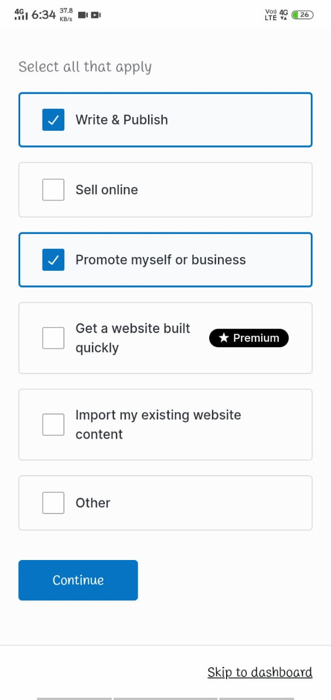
STEP 4:SELECT FREE DOMAIN

Slide 9
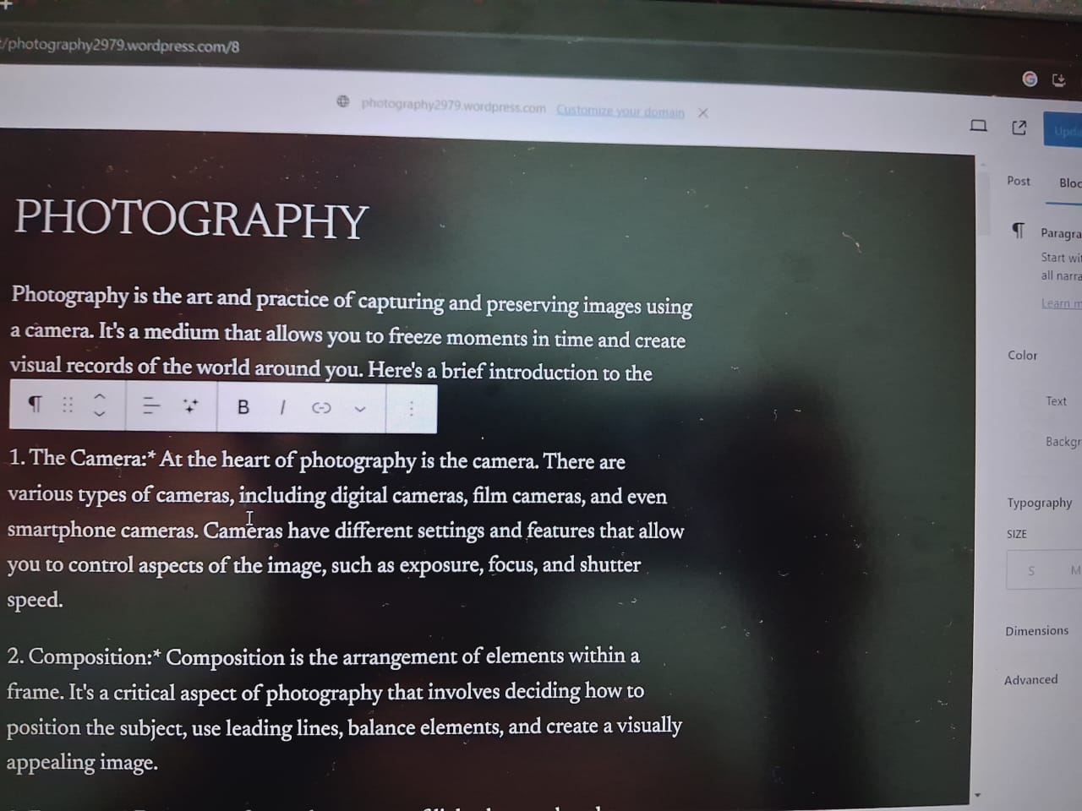
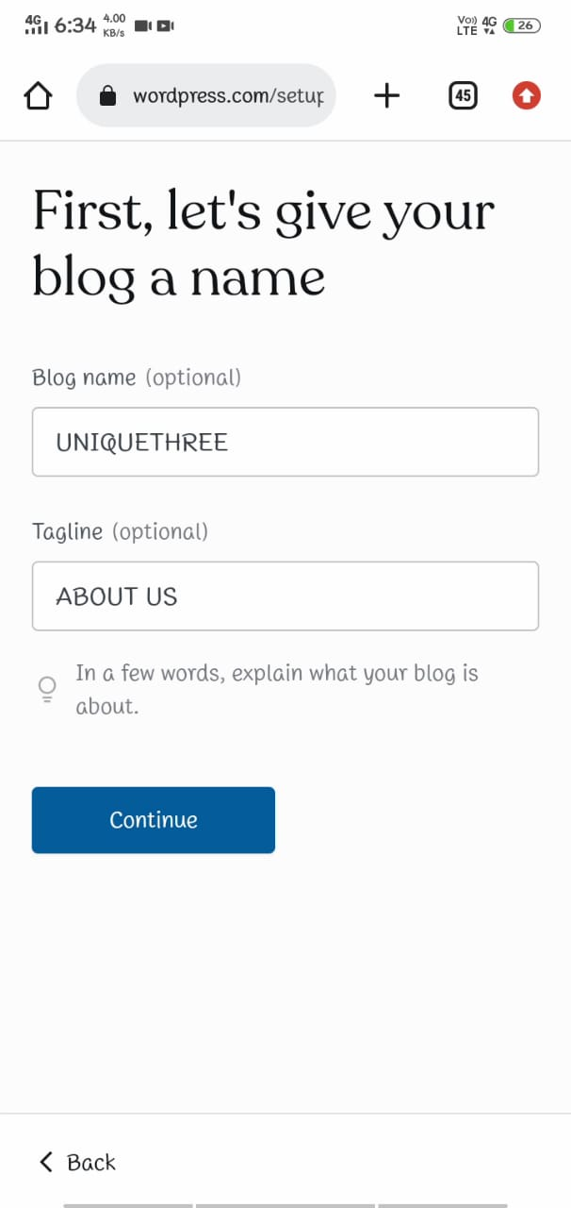
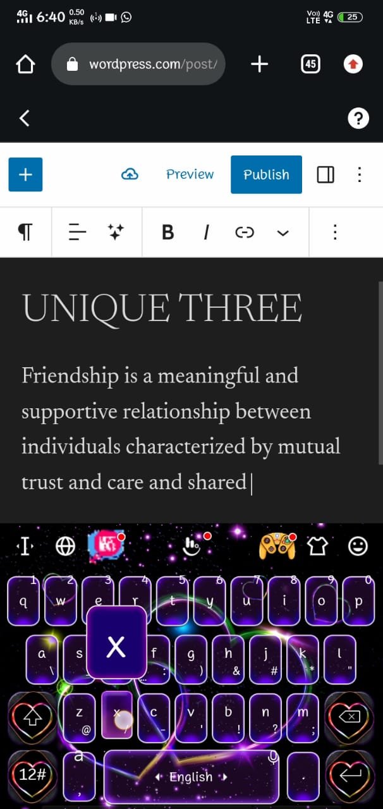
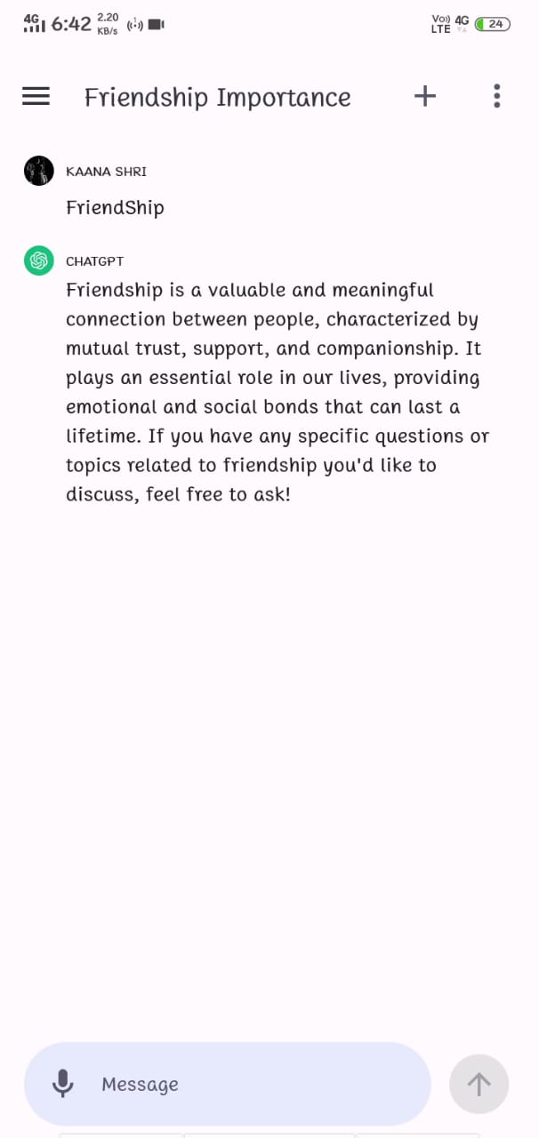
STEP 5:WRITE THE CONTENT ABOUT YOUR TOPIC

Slide 10
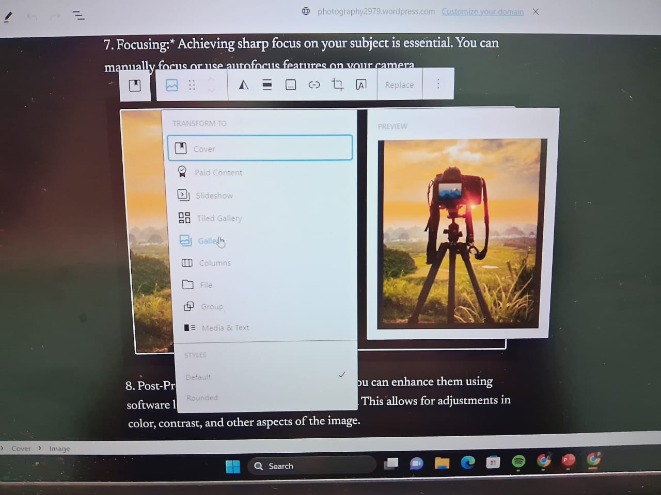
STEP 6:SELECT IMAGES FROM GALLERY

Slide 11
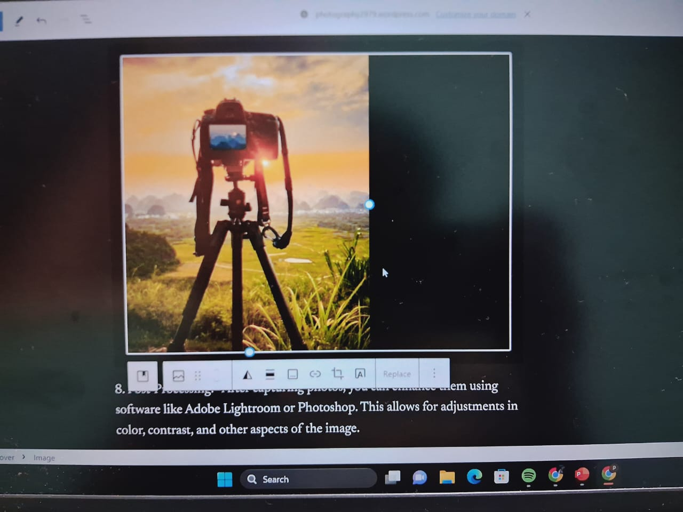
STEP 7:INSERT IMAGE TO BLOG

Slide 12
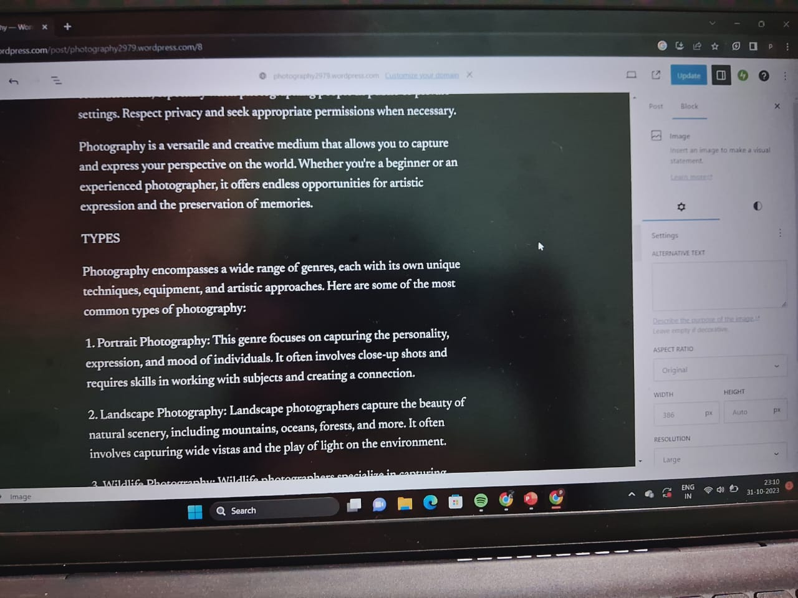
STEP 8:PUBLISH THE BLOG

Slide 13
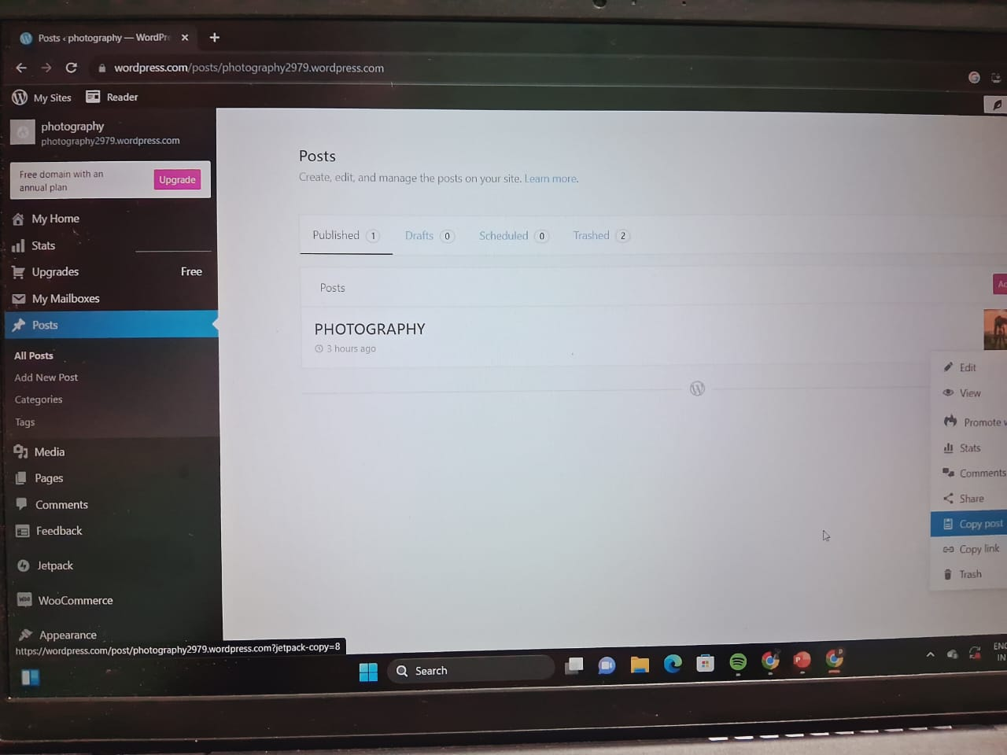
STEP 9:COPY THE LINK OF YOUR BLOG

Slide 14
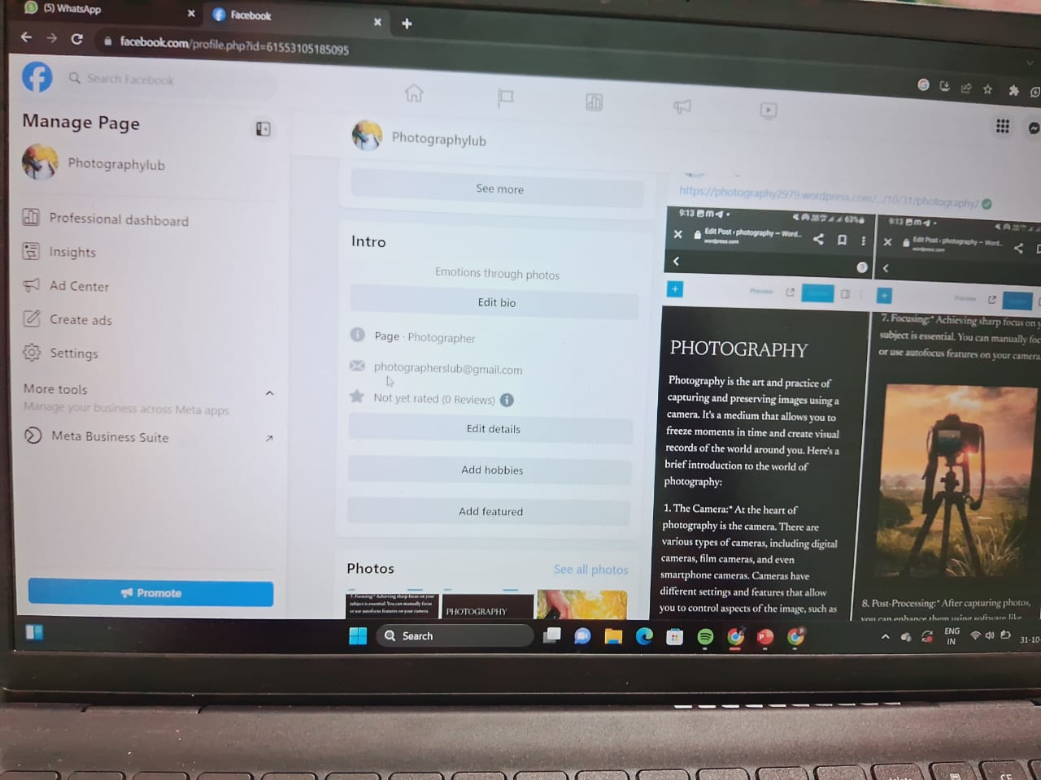
STEP 10:PASTE THE BLOG LINK IN SOCIAL MEDIA WITH A POST

